Slide 1
RS485/I2C/UART/SPI over Ethernet
WPF/Qt4.8 Open source Linux/Windows
Easy Ethernet<>Serial Bridge<>I2C<>RS485

Slide 2
Features
1.Logging serial TTL UART data up to 6.12 Mega bits/Sec Speed
2.High Speed Ethernet Communication built on top of UDP.
3.I2C/SPI Communication.
4.nRF24L01 SPI interface with 2x4 onboard header with library.
5. Credit card size board (Raspberry PI Enclosure may be used)
6. Communication library for Linux32/64/Windows platform.
7.Sample opensource Qt (Windows/Linux), WPF (Windows).

Slide 3
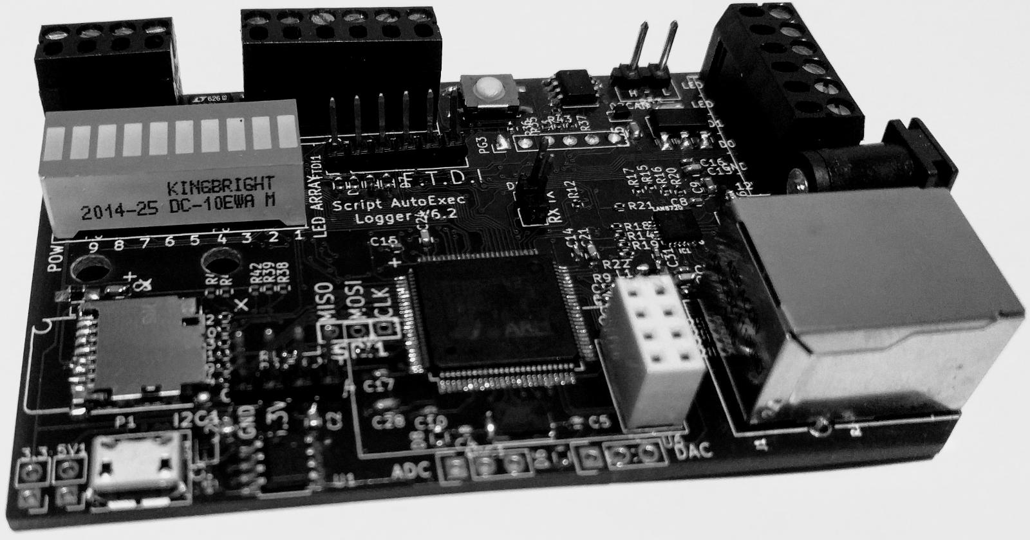
Credit card size 85x54mm

Slide 4
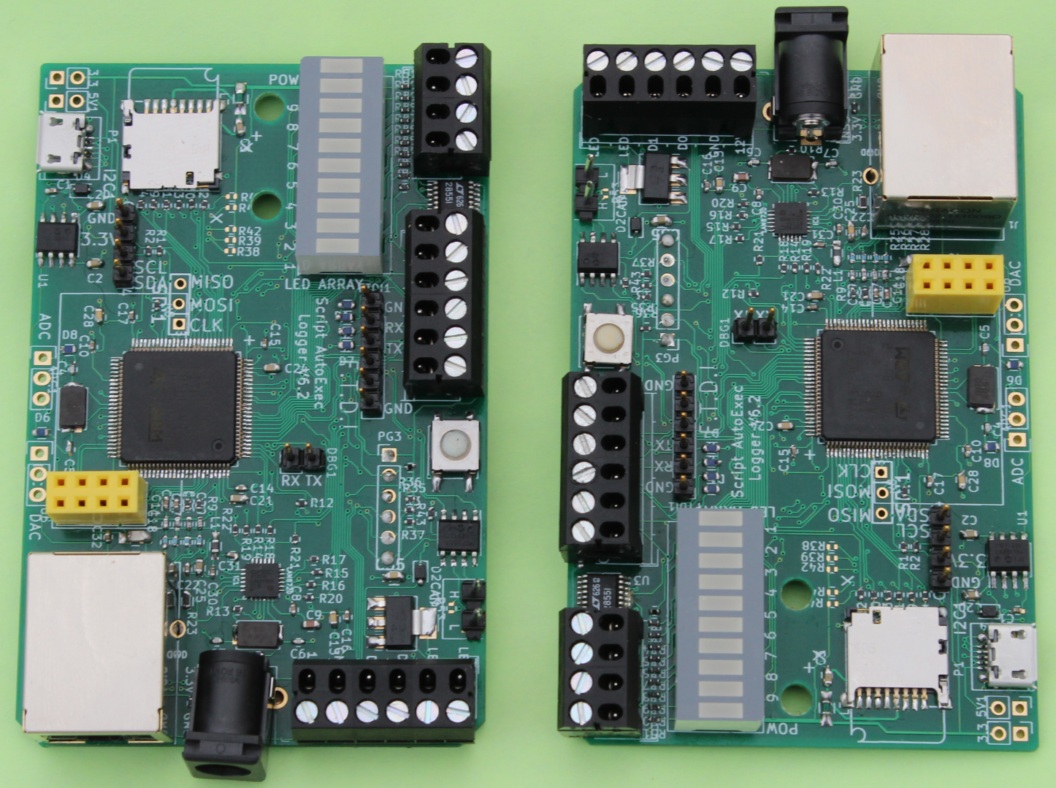
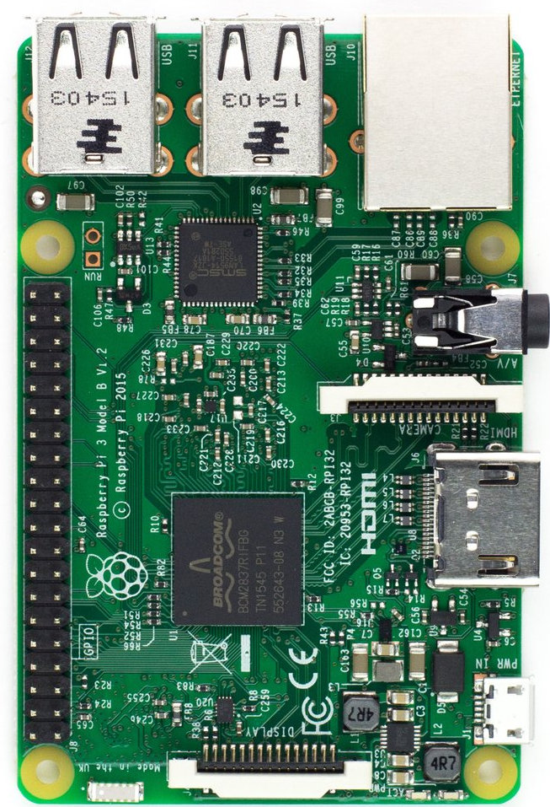
Credit card size 85x54mm (fits Raspberry Enclosure)
Just for size comparison

Slide 5
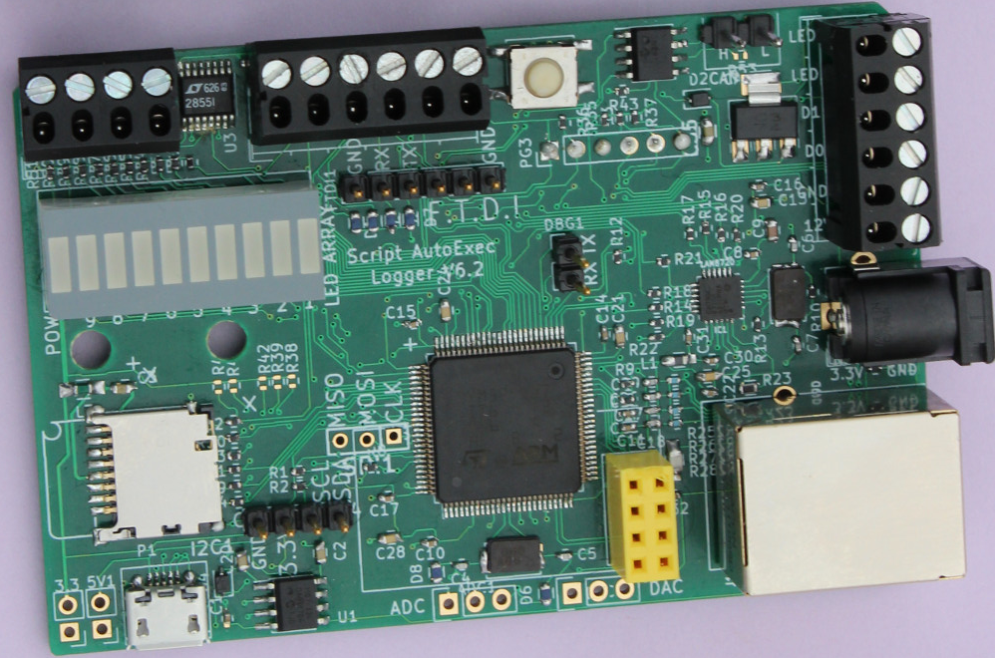
Connector
Credit card size board just like raspberry PI, it may be accommodated in raspberry PI enclosure. (Middle PIN Ground)
RS485 TX+
RS485 TX-
UART2 RX
UART2 TX
UART3 RX
UART3 TX
Reset button
CAN
Wiegand Emulator/Reader
FTDI Like TTL UART Header
LED Array
12V DC Jack
10/100 Ethernet
SD Card
nRF24L01 Header
I2C SDA
I2C SCL
Micro USB just for power supply
ADC Ch1/Ch2
DAC Ch1/Ch2

Slide 6
Samples Provided
1.Qt4.8 Serial Console with example serial terminal beagle bone black
2.Qt4.8 I2C Scanning and reading device.
3.Qt4.8 nRF2401 I2C/SPI Communication.
4.Qt4.8 RS485 HalfDuplex/Full Duplex Example.
5. CAN Bus input/output/loopback.
6. Wiegnad Reader/Wiegand Emulator

Slide 7
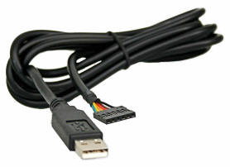
What is this Ethernet Serial Port
FTDI TTL 3.3 V Cable
FTDI TTL Cable | Parameter | Ethernet Serial Port
Single comport | Number of ports | 2 TTL RS232 + 1 RS485
0.921600MBPS | Max Baud Rate | 6.5MBPS
No | Fractional baud rate | Yes
Close source | Windows Driver | (Qt/WPF open source sample app with library provided)
Open source | Linux Driver | (Qt open source sample app with Qt4 library provided for ARM/Intel Ubuntu)
N/A | Simultaneous port IO | Yes
N/A USB power | Power supply needed | Micro USB power

Slide 8
What is this Ethernet Serial Port
FTDI TTL Cable | Parameter | Ethernet Serial Port
Easy basic setup | Setup complexity | Easy basic setup Windows/Linux
Yes | Standard COM Port | No
USB Cable Length | Cable length | Ethernet (No limit)
N/A | Recording of data into hardware | Can be dumped into SD card for analysis
--- | Field firmware upgrade | Yes
USB Cable | Physical size | Raspberry size board
Open licensed source GUI https://github.com/natashaiwscope/emulator_v0

Slide 9
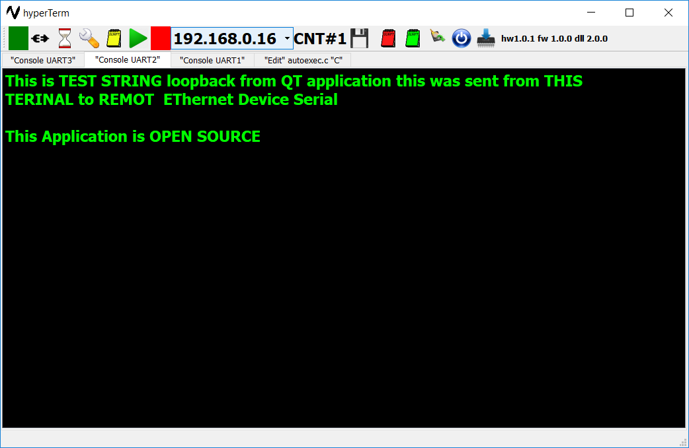
QT Sample (Open source)

Slide 10
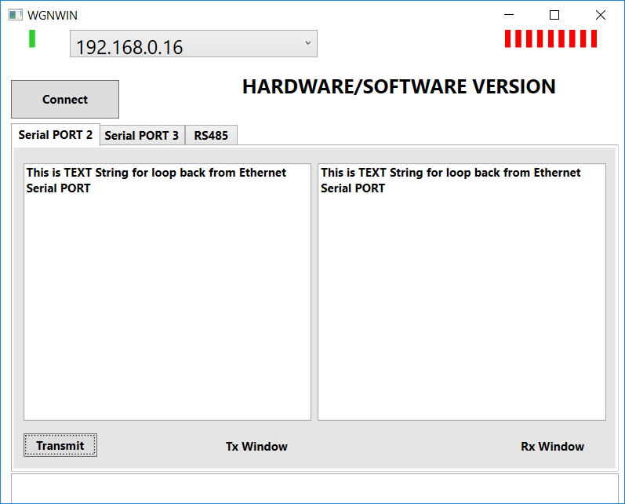
Open source WPF Sample (Serial loopback)

Slide 11
Prerequisites
Ethernet cable RJ45.
Micro USB power connector (Typical Android phone charger will work)
DHCP server where device can get iP address.
Network connected Linux/Windows computer with same DHCP server.
Few connection cable (some small cables are supplied)
Open box and connect to USB cable, one LED should turn On as soon as power is applied. Connect ethernet cable to router and hardware. Start Linux/Windows computer and launch following GUI application. Device broadcasts its IP address once every 5 seconds. PC application captures broadcast packet and autoconnect.

Slide 12
Major Milestones(Past 3 years)
Completed milestones
Hardware design and testing (Completed/Fully Tested Manufactured in small quantity)
Embedded TCP/IP firmware design. (Completed and testing/improvements)
PC Application fully complete (Enhancements and bug fix are under progress)
Bootloader for field firmware upgrade in place. (Bootloader so reliable it we prefer to use bootloader over programmer)
Risk and Challenges
Number of quantities board are contingent on ordered quantity ( Lead time may change schedule of delivery)

